Slide 1
An Observational Study of Private Equity and Employment in Africa
What is the association between PE financing and employment in Africa?
Javier Octavio Ospital Greslebin
Advisor: Vladimir Manaev

Slide 2
Plan For Today
1. Introduction: motivation and relevance
2. Research question
3. Literature Review
4. Research hypothesis
5. Research design
7. Results and policy implications
8. Limitations and future research avenues
9. Conclusions
10. Q&A

Slide 3
Private Equity (PE)
Invest in private companies through a fund in exchange for equity
Organizational form
Limited partners (LPs) finance takeovers.
General partners (GPs) actively manage portfolio companies
Transaction type
Buyouts: high leverage and a controlling stake
Growth: cash and a minority stake
Adapted from Cendrowski et al. (2012)
Motivation

Slide 4
Selected Cases of PE Promotion
Emergence of PE
Jensen (1986) and Applebaum & Blatt (2019)
Private trading in the NEEQ in China
National Equities Exchange and Quotations (NEEQ)
Li, Meng, and Wei (2015)
Development institutions promote PE
Lerner & Schoar (2004), Brenner (1999).
1980
1990
2000
2010
2020
PE co-investment facilities in Brazil, China, and India
Lerner & Schoar (2004)
The IFC and EBRD allocate billions of dollars to PE funds.
International Finance Corporation (IFC) and European Bank for Reconstruction and Development (EBRD). Brenner (1999)
The EIB commits over USD 1.6 billion to PE in Sub-Saharan Africa
European Investment Bank (EIB) (EIB, 2023)
Motivation

Slide 5
The Political Controversy Over Private Equity
“PE firms can leave the company saddled with debt and interest payments, its workers are laid off, and its assets are sold."
Danish Prime Minister Poul Rasmussen (2008)
"Typically, it's easier to decrease costs quickly by cutting heads, which is why buyouts have typically been accompanied by layoffs."
John Adler (2007), Service Employees International Union
US Senator Elizabeth Warren accused PE firms of "looting companies" and "toppling markets.”
Jamerson (2019)
Relevance

Slide 6
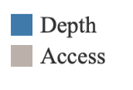
Three Decades of Sustained Financial Market Development in Africa
Figure 1. Financial Market Access Index (FMA) compiles data on the percent of market capitalizations outside of the 10 top largest companies and the total number of debt issuers (domestic and external, non-financial, and financial corporations) per 100,000 adults. The Financial Markets Depth Index (FMD) compiles data on international debt securities of government to GDP and total debt securities of financial and non-financial corporations to GDP.
Relevance

Slide 7
1) Political controversy over the employment costs of PE
3) Sustained development of African financial market depth
RQ: What is the association between PE financing and employment in Africa?
Research Question

Slide 8
Annual unemployment rates and financial market depth for African PE markets.
Relevance
Figure 2. A linear trend model is computed for average yearly unemployment given the average yearly FMD. Trendline: Unemployment = 34,3(FMD) + 2,8. The model may be significant at p $≤$0,05. R-Squared: 0,896. Standard error: 1,788. P-value (significance): < 0,0001.

Slide 9
Financial Economics and the “Growth Perspective”
Theoretical expectations. PE firms relax financing constraints and thus increase employment. Kaplan & Strömberg (2009) Wright et al. (2000; 2001).
Empirical results. Most find no significant difference in employement, but Boucly et. al (2009) finds higher employment in PE-backed companies. Davis et al. (2011; 2013) Jensen (1989) and Kaplan (1989)
Limited focus on developing countries. Davis et al. (2014) underscores the need to research cases with low financial development. Lerner and Schor (2004) and Groh (2009; 2014).
Literature Review

Slide 10
International Political Economy and “Job Destruction”
PE induces the pursuit of shareholder value at the expense of workers through two channels.
Organizational form. PE puts owners in charge of management, and they prioritize dividend payouts over investments in growth.
Transaction type. The high use of leverage places a repayment burden on portfolio companies, putting their sustainability at risk in exchange for short-run profitability
This leads PE-backed companies to reorganizations and bankruptcy.
Davis et al. (2008) Applebaum and Blatt (2014; 2019) Clark and Wójcik (2002) Guery, Wood, Stevenot, and Brewster (2017)
Literature Review

Slide 11
The “Growth Perspective” and “Job Destruction” are two countervailing strands of academic research that present:
1. Ambiguous theoretical expectations
2. Contested empirical results
3. A limited focus on African markets
Need to research PE and employment in Africa.
Literature Review

Slide 12

Testing the “Job Destruction” Hypothesis
The Null hypothesis (H₀) represents the status quo from Davis et al. (2011; 2013; 2014).
H₀$: \left|{\overline{ y }}_{ {PE−backed }_{t}}−{\overline{ y }}_{ {Corporate−backed }_{t}}\right|= 0$
The Alternate hypothesis (H₁) is derived from Appleblaum & Blatt (2019).
H₁$: \left|{\overline{ y }}_{ {PE−backed }_{t}}−{\overline{ y }}_{ {Corporate−backed }_{t}}\right|≠ 0$
Hypothesis

Slide 13
Table 1: Research Design.
Data on these variables was collected from Pitchbook, a financial information service property of Morning Star Inc. A company's industry is based on the seven industry labels identified in Pitchbook. An investor's asset under management (AUM), the amount of financing, and a company's revenue are recorded in millions of USD. Age was computed as the difference between 2023 and a company's founding year.
Methodology

Slide 14
Table 2: Balance Test
The lack of a statistically significant difference suggests that there are no meaningful differences between target and comparison groups before receiving financing, at least over these observed variables. Financing size (column 1) and assets under management (AUM) (columns 3 and 5) are in millions of USD. Statistical significance: p-value < 0.001: ***, p-value < 0.01: **, p-value < 0.05: *
Methodology

Slide 15
Table 2: Results on Number of Employees (A)
For all the periods considered, there is a significant and large difference in employment in favor of PE-backed companies over the comparison group of Corporate-backed companies. Statistical significance: p-value < 0.001: *** (3 stars), p-value < 0.01: ** (2 stars), p-value < 0.05: * (1 star).
Findings

Slide 16
Table 3: Results on bankruptcy (B) and company reorganization (C)
There is no statistically significant difference in the incidence of bankruptcy or reorganization at PE-backed companies compared to Corporate-backed companies. Statistical significance: p-value < 0.001: *** (3 stars), p-value < 0.01: ** (2 stars), p-value < 0.05: * (1 star).
Findings

Slide 17
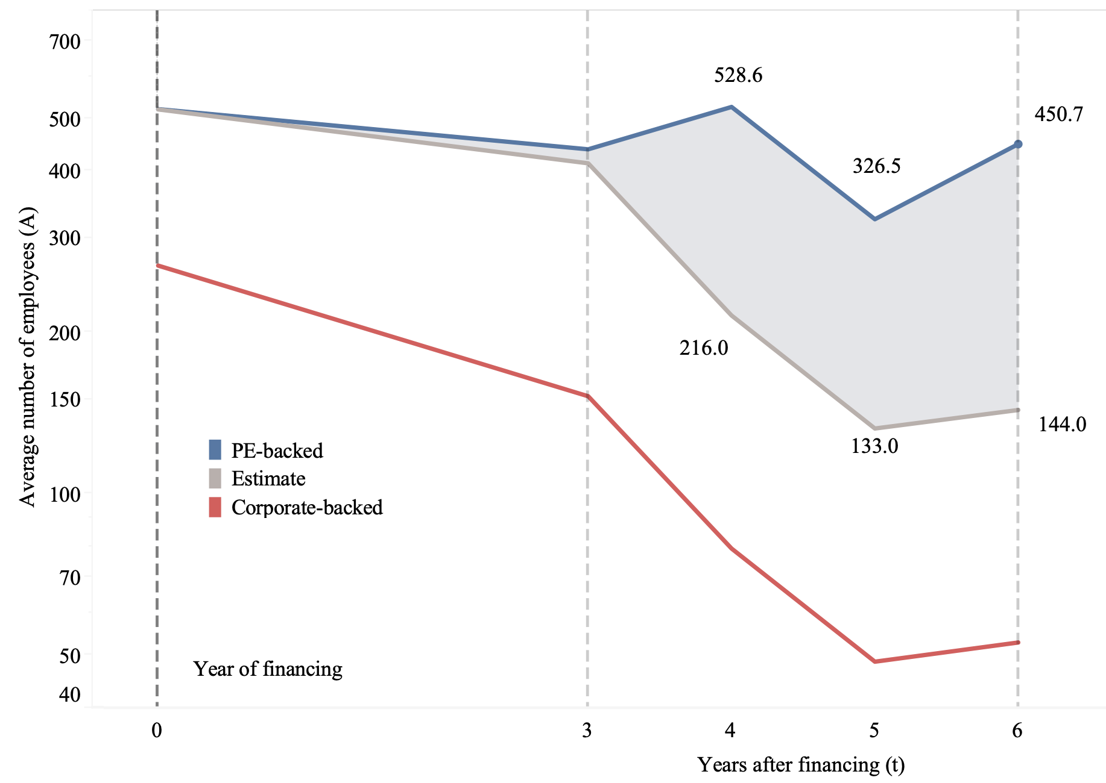
Figure 3: Employment Trends After Financing
+240 employees at PE-backed
PE-backed companies had persistently higher employment. Six years after financing, PE-backed companies had an average of 396 more employees than the comparison and 306 more than the estimated trend. $Estimate _{t}={\overline{y }}_{ {Corporate }_{t}}+\left({\overline{y }}_{ {PE }_{t = 0}}− {\overline{y }}_{ {Corporate }_{t = 0}}\right)$
Findings

Slide 18
Interpreting findings
Boucly et al. (2009) attribute a similar result to PE firms finding “hidden gems” in young markets.
The observed association between PE and high employment could depend on the existence of “hidden gems.”
Growth opportunities constrained by limited financial accessibility.
Findings

Slide 19
Figure 4: A rationale for Private Equity promotion according to financial market development
Notes. According to the IMF (n.d.) financial market ‘depth’ refers to the level of activity and volume of transactions in a given market. On the other hand, financial market ‘access’ refers to the ease with which companies obtain funding.
Conclusion

Slide 20
Finding the average treatment effect
Pre-existing difference
Limitations and Future Research

Slide 21
(B) Projecting the impact trajectory
As financial markets develop, "hidden gems" become scarce and the difference in employment could dissipate
Young PE Markets
Access to financing is limited, thus “hidden gems”
PE firms finance their growth, leading to high employment in PE-backed companies
Mature PE markets
Companies access financing with ease, scarcity of “hidden gems”
Since all companies acccess financing, there is no difference in employment in PE-backed companies
Boucly et al (2009)
Davis et al. (2011; 2013: 2014) Jensen (1989) and Kaplan (1989)
Limitations and Future Research

Slide 22
Key Takeaways
No evidence of an association between low employment and PE financing in Africa. On the contrary, PE financing is associated with higher employment through “hidden gems.”
PE should be promoted in markets where limited financial accessibility suggests the existence of “hidden gems.” However, policymakers should be wary of the high use of leverage in takeovers.
Future research could perform a difference-in-difference analysis to estimate the causal effect of PE on employment, and project the long-run trajectory of the effect on employment.
Conclusion

Slide 23
References
Appelbaum, E., & Batt, R. (2019). Private Equity Pillage: Grocery Stores and Workers At Risk. Center for Economic Policy and Research (CEPR). Available at: https://cepr.shorthandstories.com/private-equity-pillage/index.html
Boucly, Q., Sraer, D., & Thesmar, D. (2009). Leveraged buyouts - evidence from French deals. In The Global Economic Impact of Private Equity Report 2009, Globalization of Alternative Investments, Working Papers Volume 2.
Cendrowski, H., Petro, L. W., Martin, J. P., & Wadecki, A. A. (2012). Private equity: History, governance, and operations (2nd ed.). John Wiley & Sons. ISBN 978-1-118-13850-2 (cloth); ISBN 978-1-118-22542-4 (ebk); ISBN 978-1-118-23885-1 (ebk); ISBN 978-1-118-26350-1 (ebk).
Cendrowski, H., Petro, L. W., Martin, J. P., & Wadecki, A. A. (2012). *Private equity: History, governance, and operations* (2nd ed.). John Wiley & Sons. ISBN 978-1-118-13850-2 (cloth); ISBN 978-1-118-22542-4 (ebk); ISBN 978-1-118-23885-1 (ebk); ISBN 978-1-118-26350-1 (ebk).
Davis, S. J., Haltiwanger, J. C., & Lerner, J. (2011). Private Equity and Employment. National Bureau of Economic Research Working Paper 17399. Cambridge, MA: National Bureau of Economic Research. Retrieved from http://www.nber.org/papers/w17399
Davis, S. J., Haltiwanger, J. C., Handley, K., Jarmin, R. S., Lerner, J., & Miranda, J. (2013). Private Equity, Jobs, and Productivity. National Bureau of Economic Research Working Paper 19458. Cambridge, MA: National Bureau of Economic Research. Retrieved from http://www.nber.org/papers/w19458
References

Slide 24
References
Davis, S. J., Haltiwanger, J. C., Jarmin, R. S., Lerner, J., & Miranda, J. (2008). Private Equity and Employment. In Anuradha Gurung & Javier Lerner (Eds.), Globalization of Alternative Investments, Working Papers, vol. 1, Global Economic Impact of Private Equity 2009 (pp. 1-36). New York: World Economic Forum USA. Retrieved from http://www3.weforum.org/docs/WEF_IV_PrivateEquity_Report_2008.pdf
Davis, S. J., Haltiwanger, J., Handley, K., Jarmin, R., Lerner, J., & Miranda, J. (2014). Private Equity, Jobs, and Productivity. The American Economic Review, 104(12), 3956-3990. Retrieved from https://www.jstor.org/stable/43495362
Jensen, M. C., & Meckling, W. H. (1976). Theory of the firm: Managerial behavior, agency cost, and ownership structure. Journal of Financial Economics, 3, 305–360.
Jensen, R. (2010). The (Perceived) Returns to Education and the Demand for Schooling. The Quarterly Journal of Economics, 125(2), 515-548. Retrieved from https://ideas.repec.org/a/oup/qjecon/v125y2010i2p515-548.html
Rasmussen, P. N. (2008, April 10). Taming the private equity ‘locusts’. The Guardian. Retrieved from: https://www.theguardian.com/commentisfree/2008/apr/10/tamingtheprivateequitylo
Rasmussen, P. N. (2008, April 10). Taming the private equity ‘locusts’. The Guardian. Retrieved from: https://www.theguardian.com/commentisfree/2008/apr/10/tamingtheprivateequitylo
Strömberg, P. (2008). The new demography of private equity. In Globalization of Alternative Investment Working Papers Volume 1, The Global Economic Impact of Private Equity Report 2008. World Economic Forum, Geneva. Retrieved from https://www.hhs.se/contentassets/662e98040ed14d6c93b1119e5a9796a4/strombergdemography2008.pdf
References

Slide 25
References
Taylor, A., & Bryant, C. (2007, April 2). Private Equity Deals that Cement Business Growth. Financial Times. Retrieved from: https://www.ft.com/content/757b1c6c-e096-11db-8b48-000b5df10621
Trade Union Congress. (2007, May 23). Private equity - a TUC perspective. Trade Union Congress (TUC). Retrieved from: https://www.tuc.org.uk/research-analysis/reports/private-equity-tuc-perspective
Clark, G. L., & Wójcik, D. (2003). An Economic Geography of Global Finance: Ownership Concentration and Stock-Price Volatility in German Firms and Regions. Annals of the Association of American Geographers, 93(4), 909–924. http://www.jstor.org/stable/1515361
Guery, L., Stevenot, A., Wood, G. T., & Brewster, C. (2017). The Impact of Private Equity on Employment: The Consequences of Fund Country of Origin—New Evidence from France. Industrial Relations: A Journal of Economy and Society, 56(4), 723-750.
Wright, M., Amess, K., Bacon, N., & Siegel, D. S. (2008). The impact of private equity-backed buyouts on employee relations. Centre for Management Buy Out Research. Available at: https://www.lborolondon.ac.uk/media/wwwlborolondonacuk/downloads/research/enterprise-development/doc_rp_cmborstudy_1.pdf
Jensen, M. (1986). Agency costs of free cash flow, corporate finance, and takeovers. American Economic Review, 76(2), 323–329.
Jensen, M. C. (1989, revised 1997). Eclipse of the Public Corporation. Harvard Business Review. Available at SSRN: https://ssrn.com/abstract=146149 or http://dx.doi.org/10.2139/ssrn.146149
References

